Slide 1
Computer-Aided Diagnostics of Prostate Cancer with Automated Image Analysis using Expert-Supervised Machine Learning
Benjamin Warrick

Slide 2
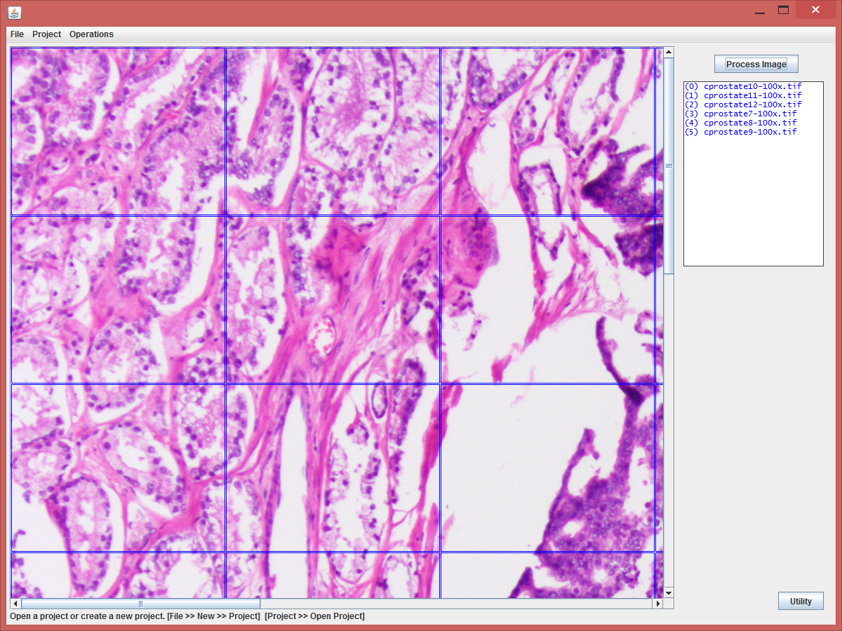
Goal
Software that can learn directly from a pathologist well enough to assist a pathologist in diagnosing prostate cancer.

Slide 3
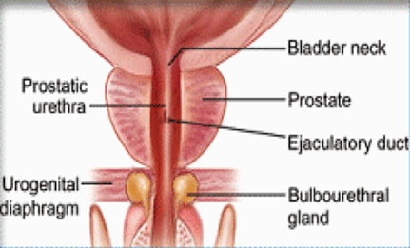
Why Prostate Cancer?
Relatively easy to diagnose.
Plenty of data.
Prostate cancer is the most common form of cancer in men, other than skin cancer.
Diagnosis is arduous!

Slide 4
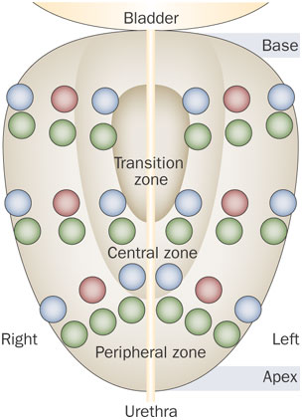
Prostate Cancer Screening
PSA Test
Palpation
Biopsy
12-130 needles

Slide 5
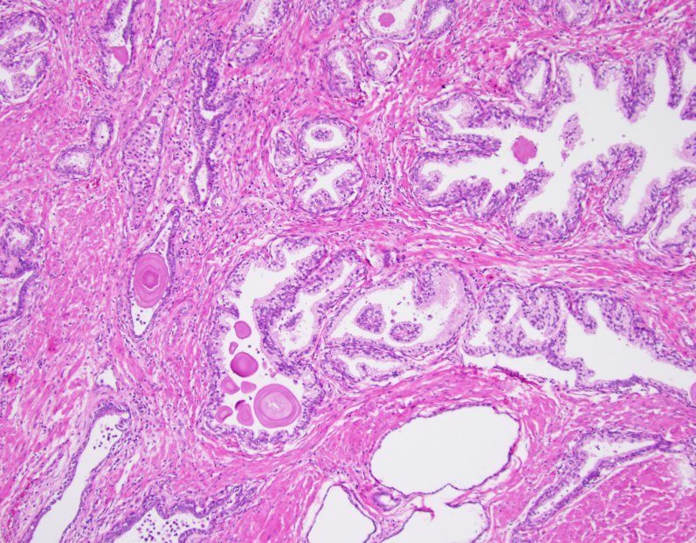
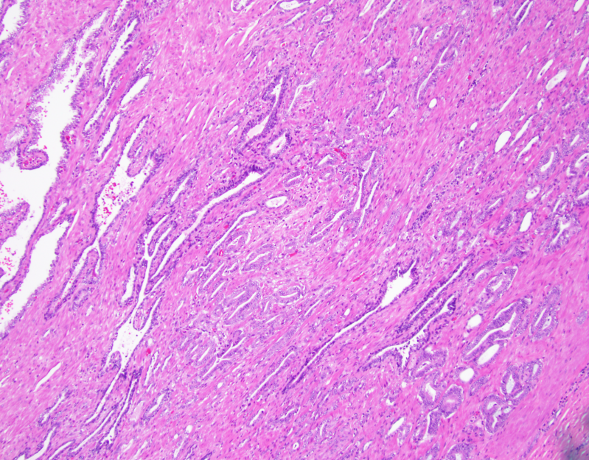
Diagnosis
36 to as many as 390 slides!
Requires a pathologist to study each slide
Highly accurate – very slow and expensive

Slide 6
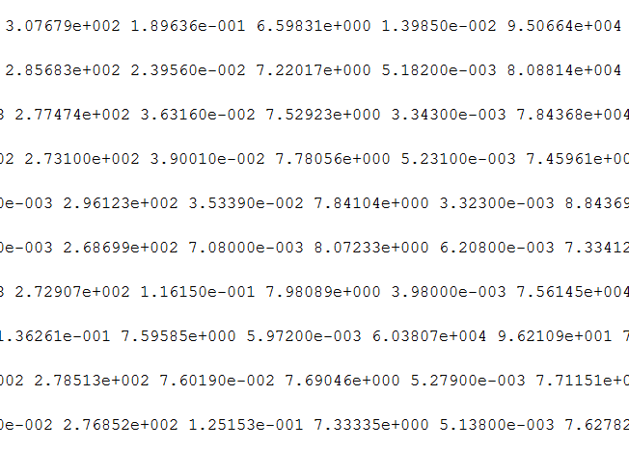
Machine Learning
If A and B then C
If C or D then not E If A and E and (B or F) then G
Programming a computer to act without having to program it specifically.
Good examples:
Voice recognition software.
Google’s self driving car.
Customer behavior prediction
Search engines

Slide 7


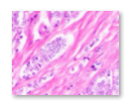
wndchrm
C
B
Open source utility for biological image analysis, developed by Dr. Shamir and colleagues.
?
% Accuracy

Slide 8
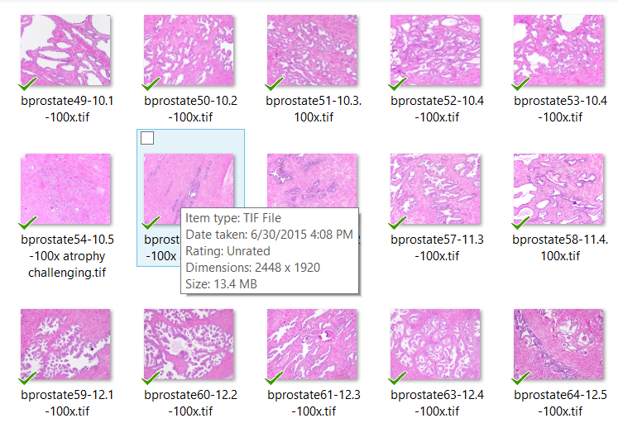
Data!
Initial Data Set:
220 100x Magnification 260 200x Magnification
Half cancer, half non-cancer
Taken from cancerous prostectomy
13.4MB
2448 x 1920 pixels

Slide 9

wndchrm accuracy on its own
110 100x |  |  | 130 200x
Features | Accuracy |  | Features | Accuracy
50 | 0.796296 |  | 50 | 0.801562
40 | 0.785185 |  | 40 | 0.770312
30 | 0.796296 |  | 30 | 0.820313
20 | 0.833333 |  | 20 | 0.784375
10 | 0.805556 |  | 10 | 0.809375
5 | 0.861111 |  | 5 | 0.84375
2 | 0.87037 |  | 2 | 0.857812
AH!!!!!!!!

Slide 10

Parallel Processing
wndchrm
wndchrm
wndchrm
wndchrm
wndchrm
wndchrm
wndchrm
wndchrm
wndchrm
wndchrm
wndchrm

Slide 11
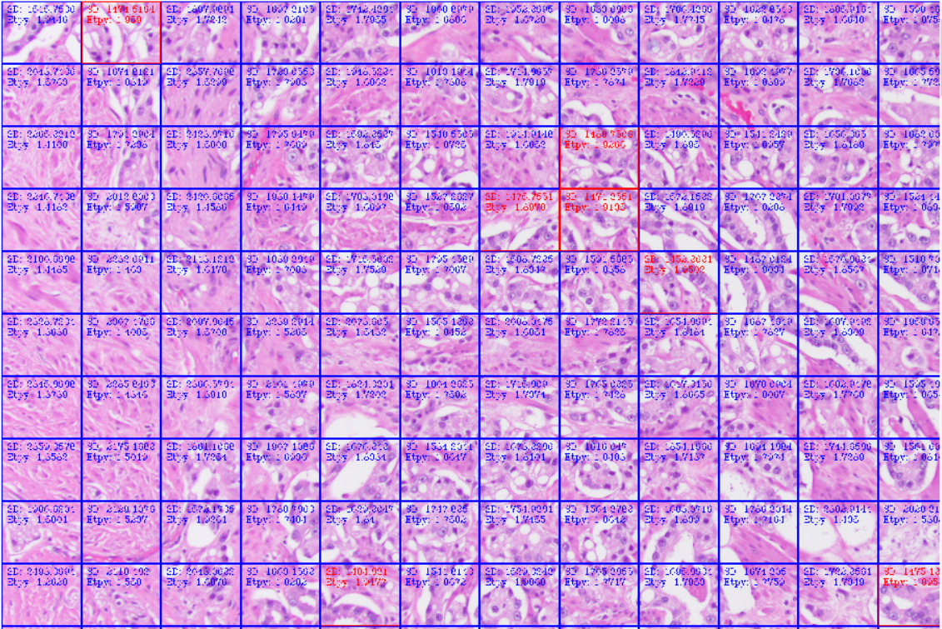
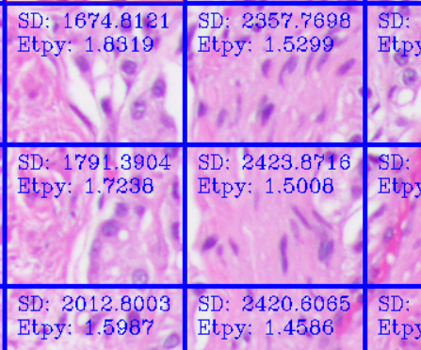

ROI Analysis
MUCH easier on CPU
OpenCV .Net C#

Slide 12
ROI Experiments
Best results with low standard deviation.

Slide 13

Conclusion: Yes, a software system can be trained to identify cancer!
Why?
Boosting
Hands-on human supervision
Improved methods
Tile size
Extra training in troubled areas

Slide 14
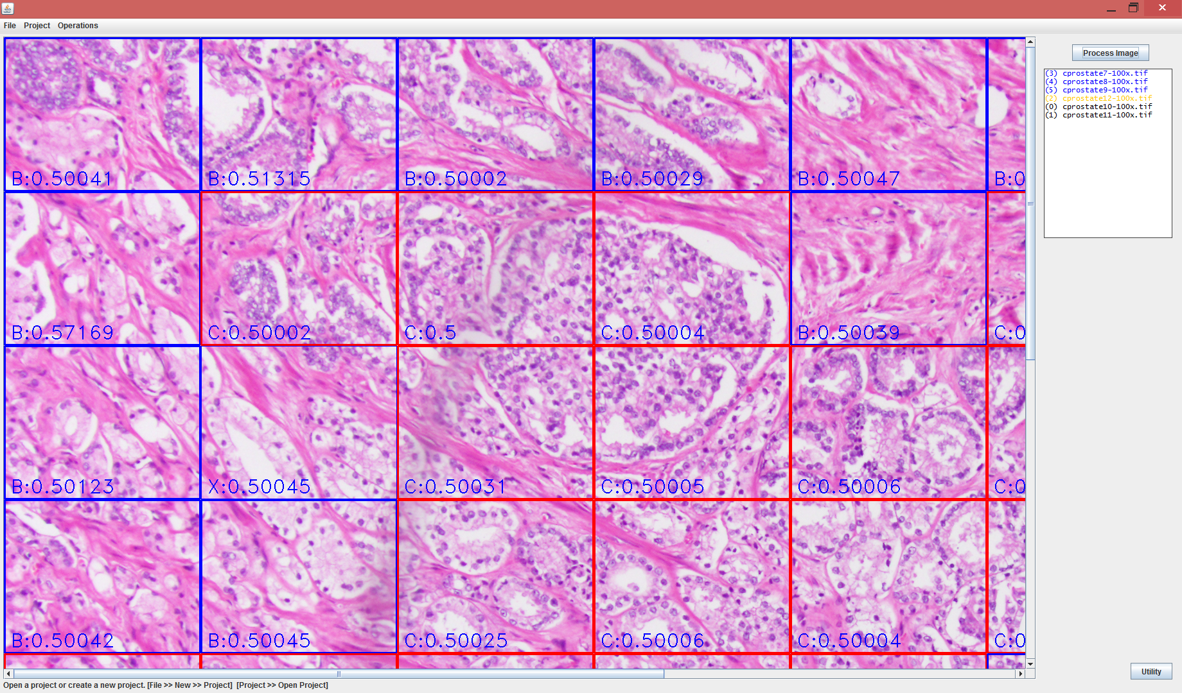
J2 – A software system that can be trained to identify cancer.

Slide 15
J2
Construction
Java
OpenCV
wndchrm
Features
Create a project
Add images
One by one, correct each image.
C
B
?

Slide 16
First Experiment
46 images total
15-20 minutes processing time per.
75%-78% accuracy
23 100x
Features | Accuracy
50 | 0.74959
40 | 0.746995
30 | 0.753825
20 | 0.764754
10 | 0.778962
5 | 0.785929
3 | 0.778689
2 | 0.760109

Slide 17

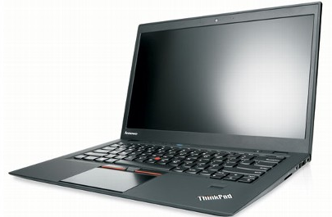


Problems | Solutions
Need more experiments | More a planned
Need more data | We’re getting more data
Cumbersome interface | Make interface improvements
CPU intensive | Parallel processing and LOTS of CPUs

Slide 18
But How?
Desktop
Application
Remote
Procedures
Remote Procedure Calls?
Remote Desktop?
Client Server (Web Page)???
Remote Session
Desktop
Desktop
Application
Desktop
Web
Server
Application

Slide 19
Cloud-Based Architecture
Server
Client
Database
Java Application
JavaScript/HTML
Interface
wndchrm
File
System
AJAX
&
Parallel Processing
Plenty of CPUs

Slide 20
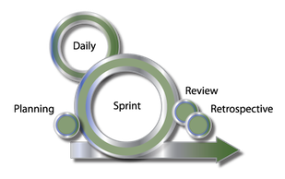
Software Features
85%
Speed!!!
Improved image display
Different tile sizes
Change image order
Accuracy test
Goals
Rediscover >85%
Improve beyond 85%
Create a practical automated cancer screening system

Slide 21

The Long-term Goal
Java Application
Features
A network of systems contributing to a common learning set
Different forms of cancer
Rivals the accuracy of human pathologists

